Slide 1
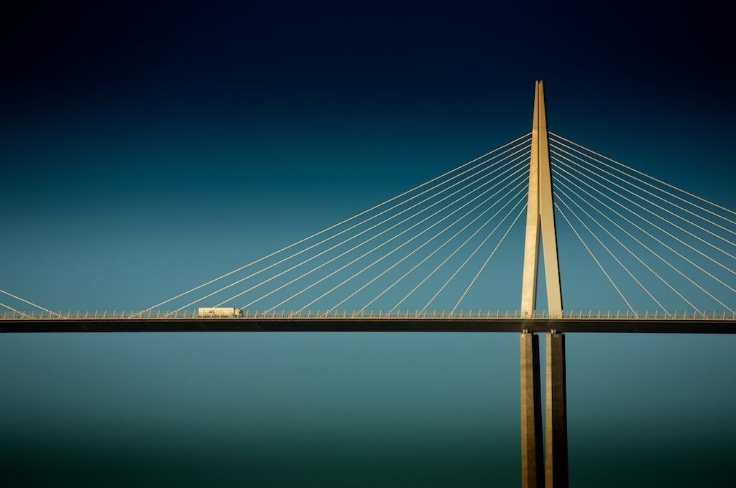
CE 122/123L
Byzantine
Structural
Yanlong Ma (CEO)
Yiqiu Zhang (Principal),
Brian Tam (Estimator), Omar Natouf (Intern), Shien Jinn Sam (Project Engineer),

Slide 2
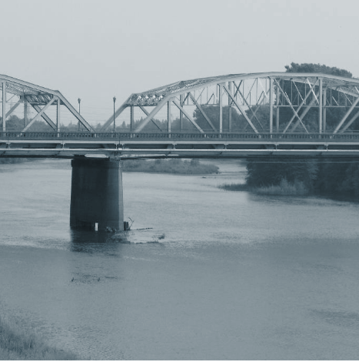
The Problem
Notes:
-Additional vehicular traffic is required at the J St. Bridge near CSU Sacramento

Slide 3
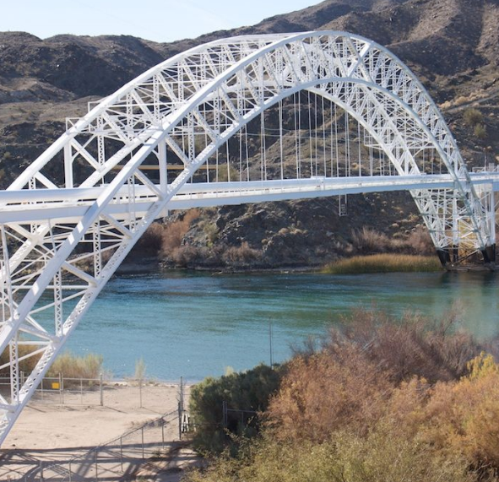
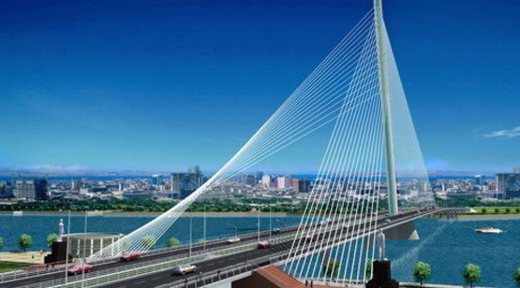
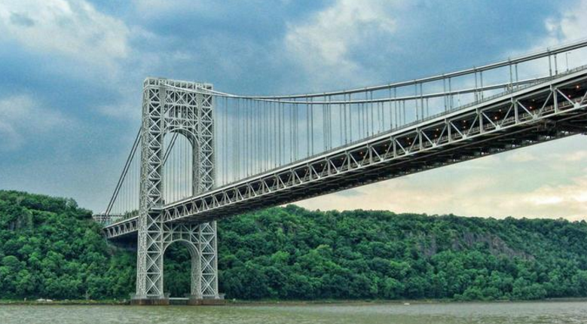
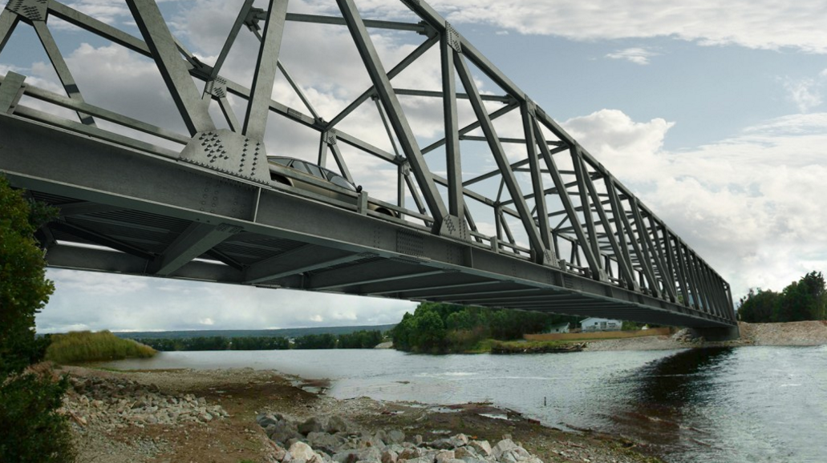
Existing Alternatives: An Overview
4 Mainstream Design Solutions:
Compression Arc Cable Stayed Suspension Truss

Slide 4
Our Proposal:
A Cable Stayed Approach

Slide 5
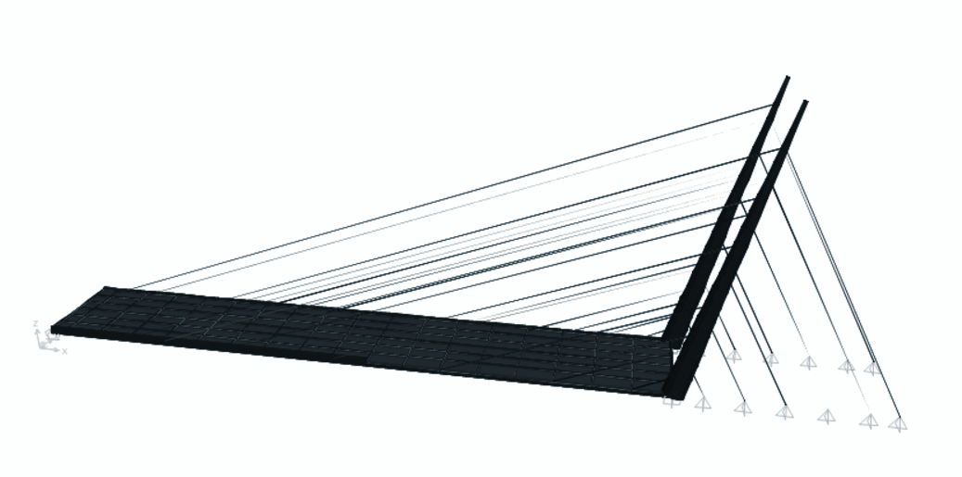
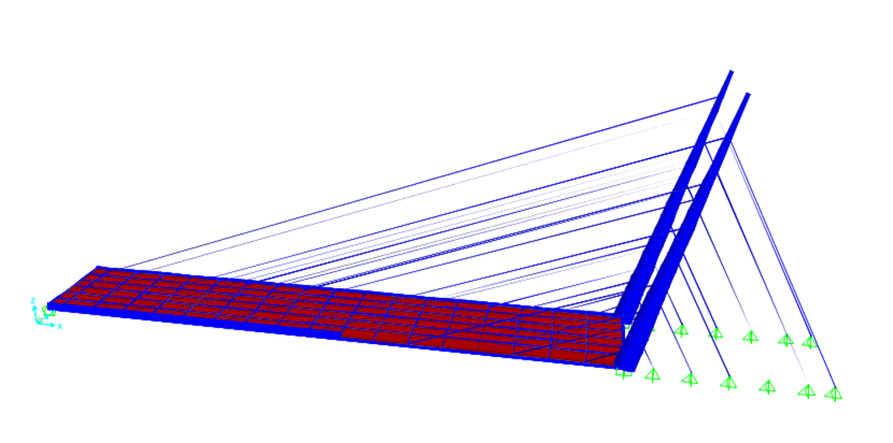
The Asymmetric-Cable Stayed Solution

Slide 6
Key Design Considerations

Slide 7
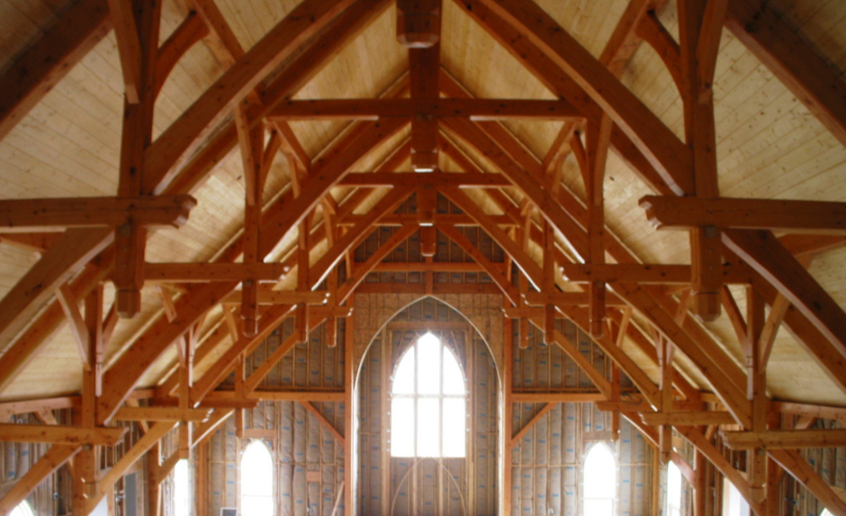
Reliabiliy: A Structural Perspective
Lighter than most conventional arch and truss designs
Greater stiffness than suspension bridges
Reduced live load deformations
Deck remains only in compression
More flexible than arch and truss bridges

Slide 8
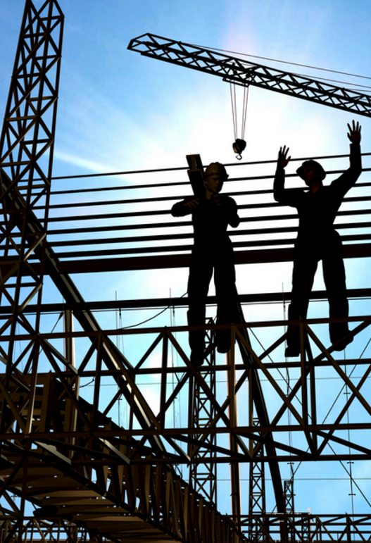
Constructability: An Exercise in Practicality
-Cable stayed bridges do not require anchorages.
-Temporal supports not required, access to construction not required from beneath
-Bridge decks can have deck sections replaced for widening of traffic lanes
-Higher stiffness than suspension means less aerodynamic profiling to combat wind vibration

Slide 9

Bridge Economics:
A Macro and Microscopic Examination
-Requires less material than most other bridge types. Lower material cost.
-Does not require costly foundation work
-Minimal economic disruption because minimal construction disruption of surrounding area.
-Low environmental study cost because development is not invasive to the river.

Slide 10
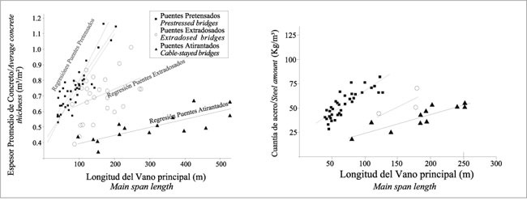
Quantitative performance comparison and scaling: Materials

Slide 11
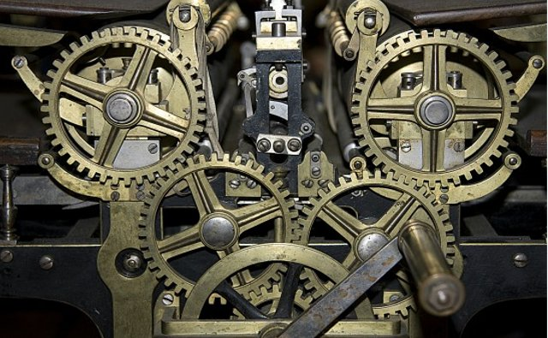
A Dive Into The Technical Details

Slide 12
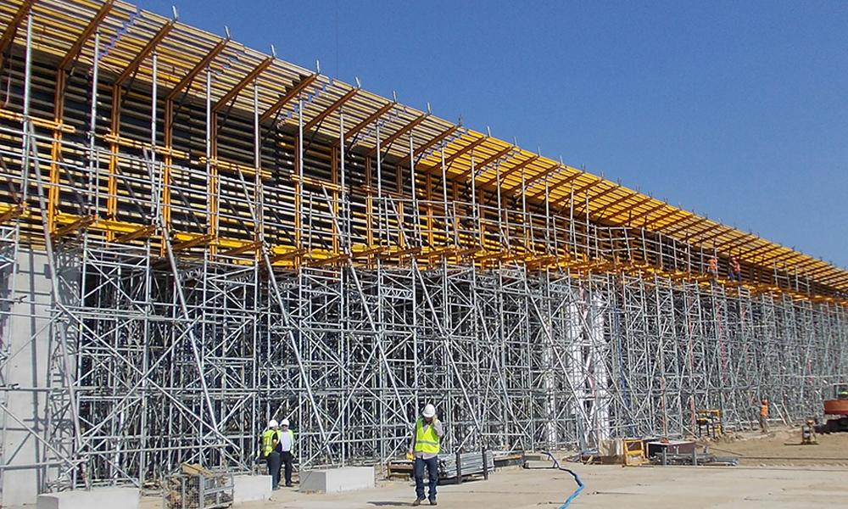
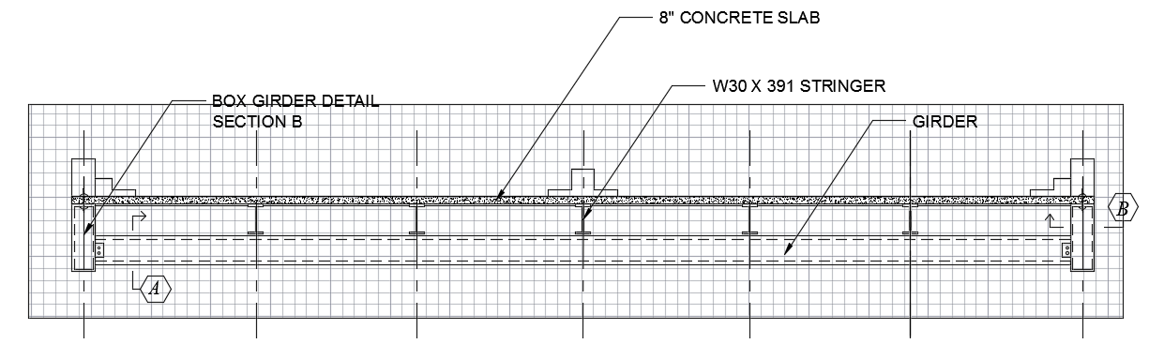
Design Drawings: Deck

Slide 13
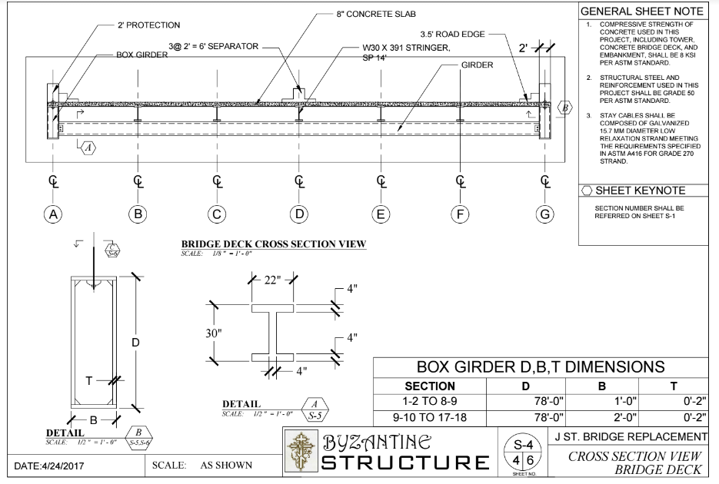

Slide 14
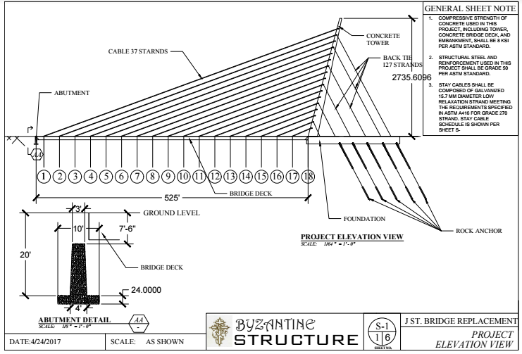

Slide 15
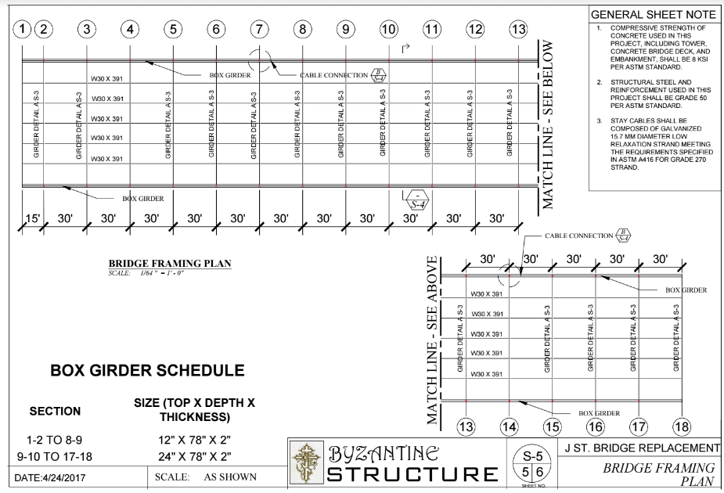

Slide 16
Components | Material | Grade | Notes
Slab | Concrete | 8 ksi | Steel ratio in the concrete is 2%
 | Steel Rebar | 60 ksi
Stringer | Steel | A572 (50 ksi) | W30 391
Girder | Steel | A572 (50 ksi) | Built up W shape 22”4” Flange, 4”22” Web
Edge Girder | Steel | A572 (50 ksi) | Built up HSS, 12”78”2” for deck #1 - #8, 24”78”2” for deck # 9 - #17

Slide 17
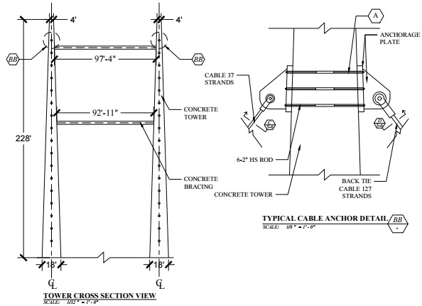

Slide 18
Pylon
Pylon (each) |  | Quantity
Shape |  | Cone
Height (ft) |  | 228
Length (ft) |  | 236.04
Tilt Angle (Deg) |  | 15
Bottom Diameter (ft) |  | 18
Top Diameter (ft) |  | 4
Materials | Steel (ksi) | 60 | Steel ratio is 0.02
 | Concrete (ksi) | 6
Weight (ksi) |  | 4000

Slide 19
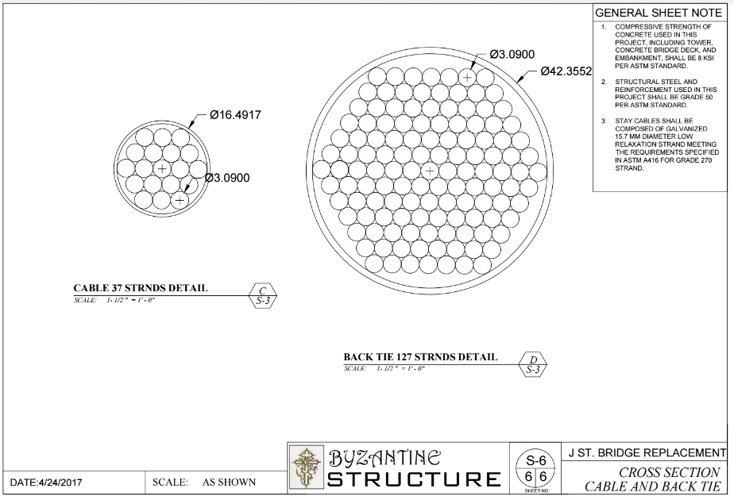

Slide 20
Cable
Seven-Wire Strand Cable | Properties
Diameter | 15.7 mm
Effective Area | 150 mm
Grade | 270
Tensile Capacity | 62.775 ksi
Front Cable | 37 Strand | 2323 ksi
Back Cable | 127 Strand | 7972 ksi

Slide 21
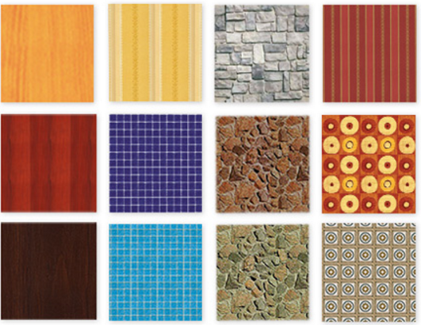
Material Costs

Slide 22
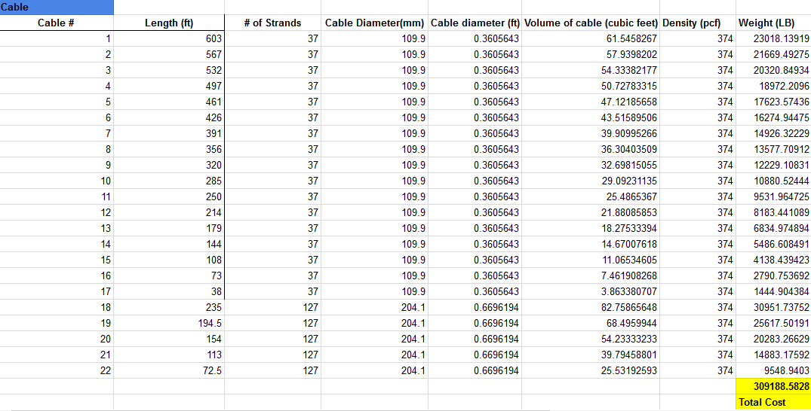

Slide 23
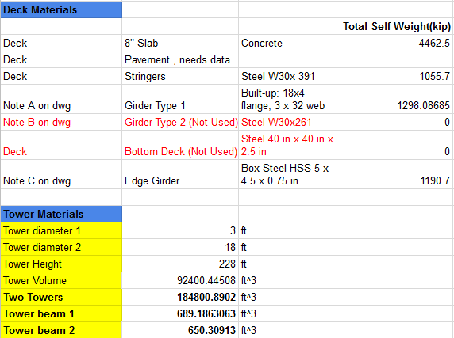

Slide 24
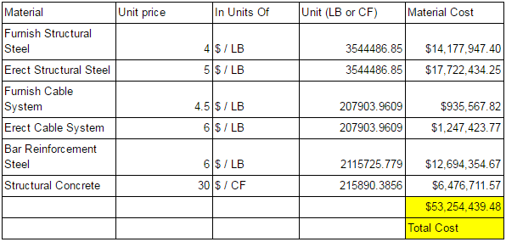
Cost Analysis

Slide 25
Cost per square footage of deck:
$1139.64

Slide 26
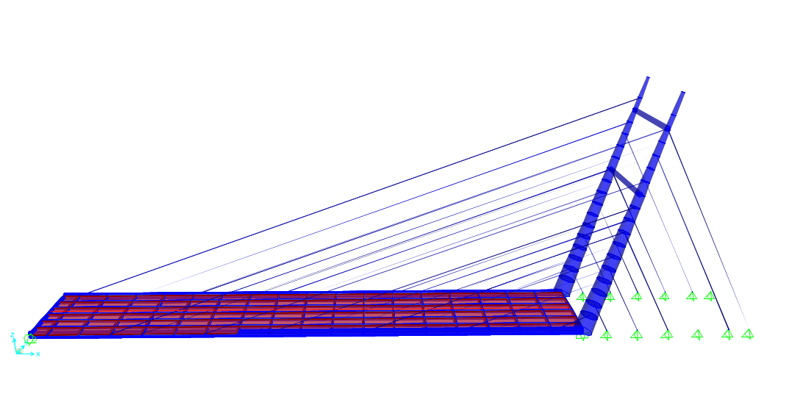
Undeformed Shape

Slide 27
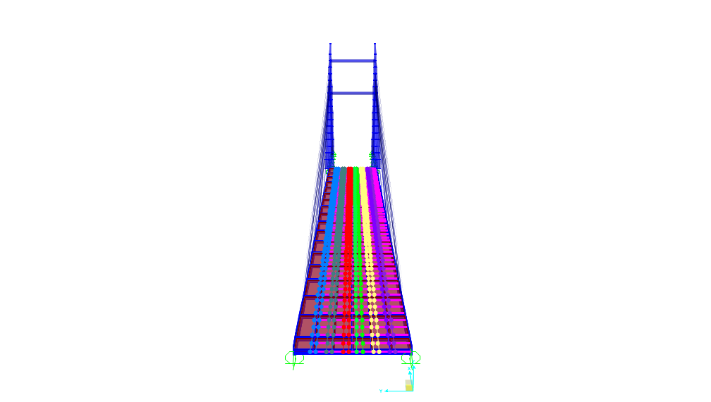
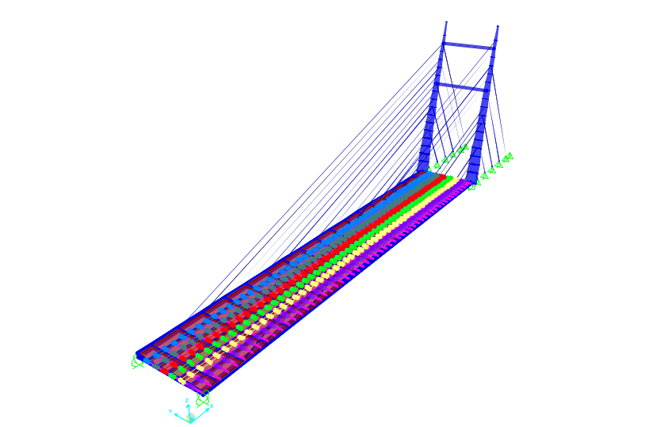
Live moving loads

Slide 28

Mode Shape
T=2.23 s

Slide 29
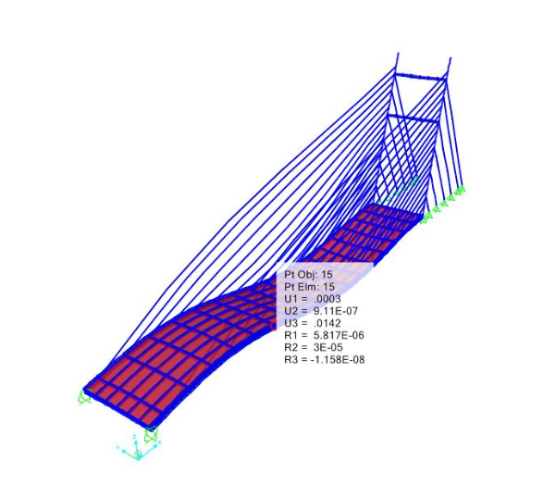
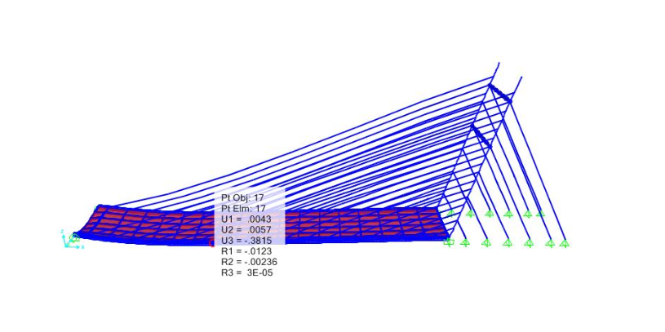
Deformed Shape Deflections

Slide 30
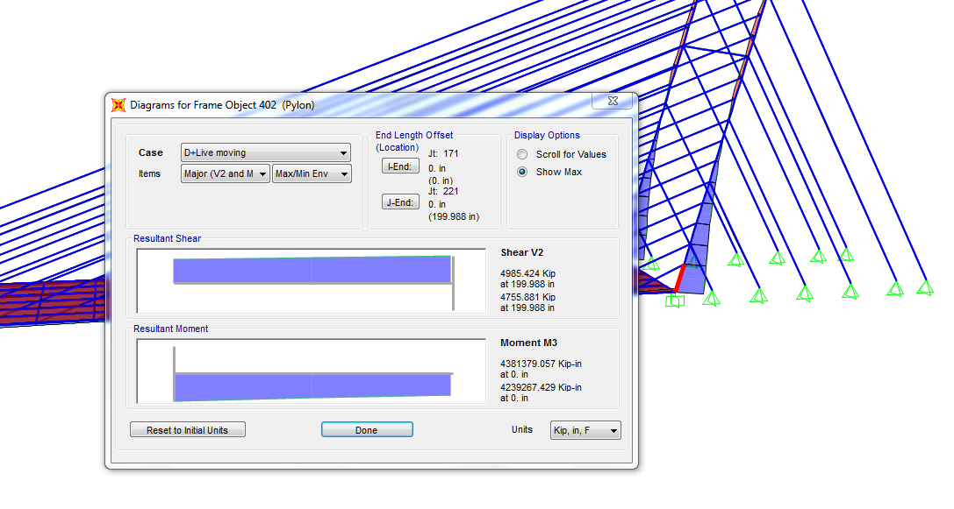
Pylon Capacity: 9.6E10⁶ kips
Factor of safety: 2.3
Notes:
The shear and moment in the critical section of the pylons

Slide 31
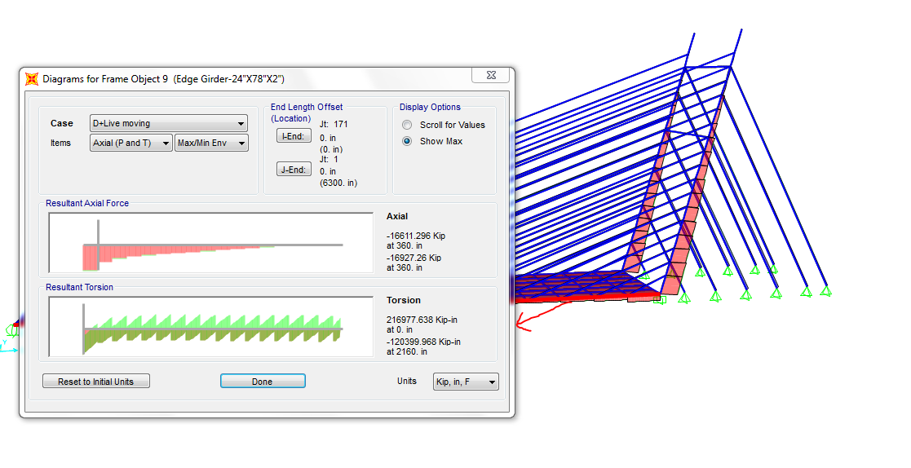
Edge Girder Axial Forces
Capacity: 17E10³ kips
Factor of safety: 1.1
Notes:
The edge girder axial forces
The capacity 17E10^3 kips
Factor of safety 1.1

Slide 32
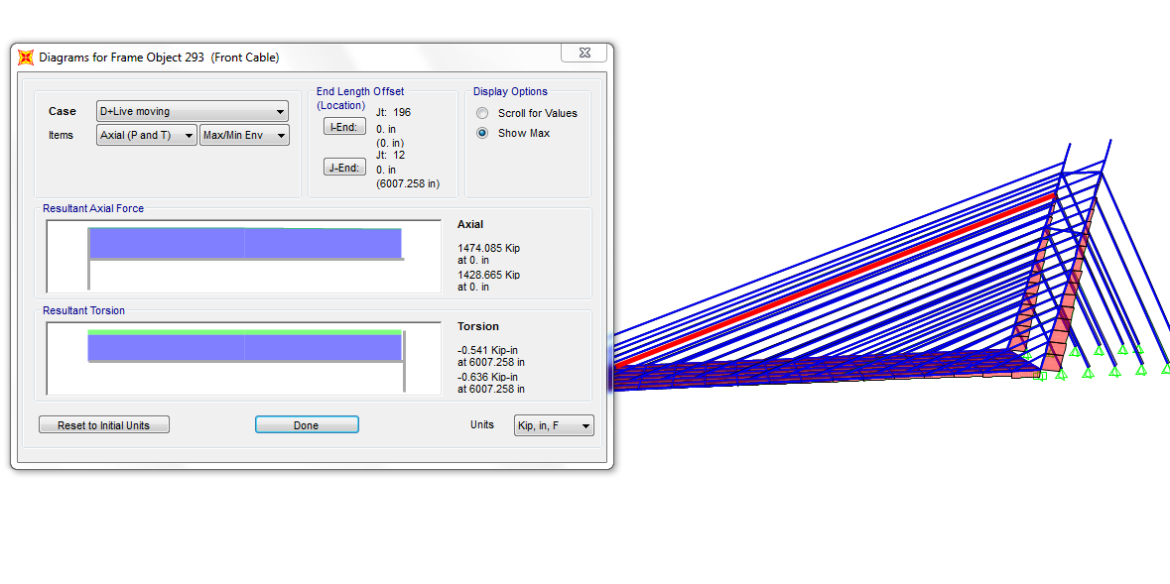
Cable Axial Forces
Capacity 2332 kips
Safety Factor 1.5
Notes:
Cable axial force
Capacity 2334 kips
Safety factor 1.5
Not sure about torsions

Slide 33
Construction of Cable Stay Bridge
Foundations
Pylons
Cables
Deck

Slide 34
Thank You!
Questions?

